Slide 1
Where the dragon to fly
Thank you very much for giving me a very big opportunity to express my opinion and thought about issues of society and education. This is my biggest honor and happiness. You may be surprised at the speech title “Where the dragon to fly” and so, I start my speech with an introduction to generative artificial intelligence (generative AI or GenAI). As you knew, generative AI is being the hot topic, especially, there are some miracle applications such as ChatGPT and Bard. There are two main applications of generative AI:
Generative AI model incorporated into natural language processing, which produces a so-called large language model, aims to generate human-understandable content like ChatGPT.
Generative AI model aims to generate digital content like sound and image.
Both models apply deep neural network into generating task. This speech mentions the generative model for digital content generation called digital generative AI model whose taxonomy is listed in the next slide. Such model aims to generate the dragon’s orbit as mentioned in the speech title.

Slide 2
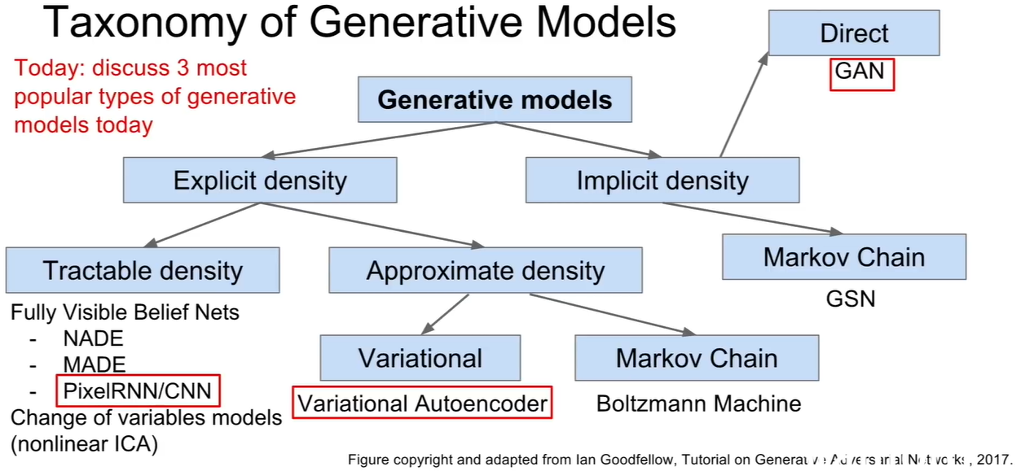
Introduction to digital generative AI

Slide 3
Introduction to digital generative AI
In education, generative AI is more than potential, not only tutorial and helper applications but also creative applications to create new solutions, new puzzles, new game learning methods. In order to illustrate an application of digital generative AI model, in the next slide, there is a dragon, a tiger, along with a background of bamboo tree, generative AI application can generate orbits or moving journeys of the dragon. Note, the next slide is the illustration of movement, which is not realistic generation yet.

Slide 4
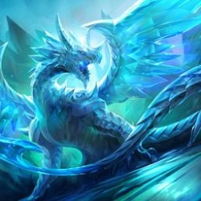
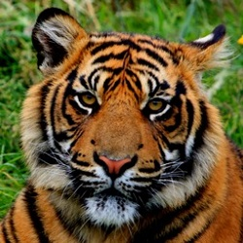
Where the dragon to fly
However, indeed the generative AI application needs to know some basic orbits of dragon and tiger (as seen in next figure) to estimate variants of their orbits. Moreover, as you see, the bamboo background is not changed much, and some swallows are flying happily, healthily, and freely. Of course, the number of the swallows is more than two or three.

Slide 5
Strategic blind spots
Of course, you knew almost what I meant, but mainly mentioned here, from the digital generative AI model to issues of education and society, there are differences between ideas, thoughts, cultures, opinions, and viewpoints as well as differences between natural science and social science, but these differences are not clear and there are shifts and transformations among them like the dragon’s orbits.
However, the fact that there are too many events in technology as well as society and politics causes a blind spot which is an emergent feeling that the world is changing too fast although it indeed is changing.
For instance, the world order is not changed much because the development of peripheral centers regarding viewpoint of contemporary history is coping with and obstructed by the serious problem of climate change including global warming and environmental pollution, which implies that such development will not obey principles of history. Of course, the role of non-governmental organizations is also very important for shaping the world order.

Slide 6
The dragon to fly into the universe
The economical decline of some superpowers “hide” their efforts to improve other values about humanity, life quality, soft power, etc. In other words, their powers are not decreased actually or seriously, indeed.
Trade protectionism is dominating trade liberalism after its decay while everyone is making efforts about anti-protectionism. One of main causes is climate change too.
Therefore, the idea of exploiting outer-space resources as well as migrating to other planets is great, which will solve many problems as well as liberate power and creativeness again. In other words, the dragon is flying into the universe.

Slide 7
The dragon to fly back home
On the other hand, the world becomes narrower and so, the university is moving back home so that everyone can study himself/herself with support of AI. The education and lifelong study will be changed in essence.
Therefore, the dragon is flying back home whereas the dragon is flying into the universe too. What thing is occurring?
The answer is that the Earth is the center of universe in the near future at least, not the Sun, as in the Bible. Again, climate change and its related problems such as green development and intelligent society are the center of everything.
There may be a doom in mankind world, but such doom is too far away from now (only) for current decision makers to worry about it and maybe, there can be some transformation (maybe in nature) or migration in the far future. However, difficulties and disasters are obvious.

Slide 8
Have to find an “enemy”
As aforementioned, climate change is negative problem needing to be solved, especially, narrowing the serious gap between the poor and the rich, but one of its positive aspect is that some superpowers are “waiting” for other superpowers to reach some goals. Of course, such waiting is unexpected.
However, the most important positive factor of the climate change problem is that climate change is the glue to glue up all nations to overcome obstacles as well as develop our civilization and humanity as well as possible.
In other words, climate change is a common “enemy” we must recognize and fight for peace. Of course, such “enemy” is simulative enemy.

Slide 9
Thank you for listening

